Slide 1

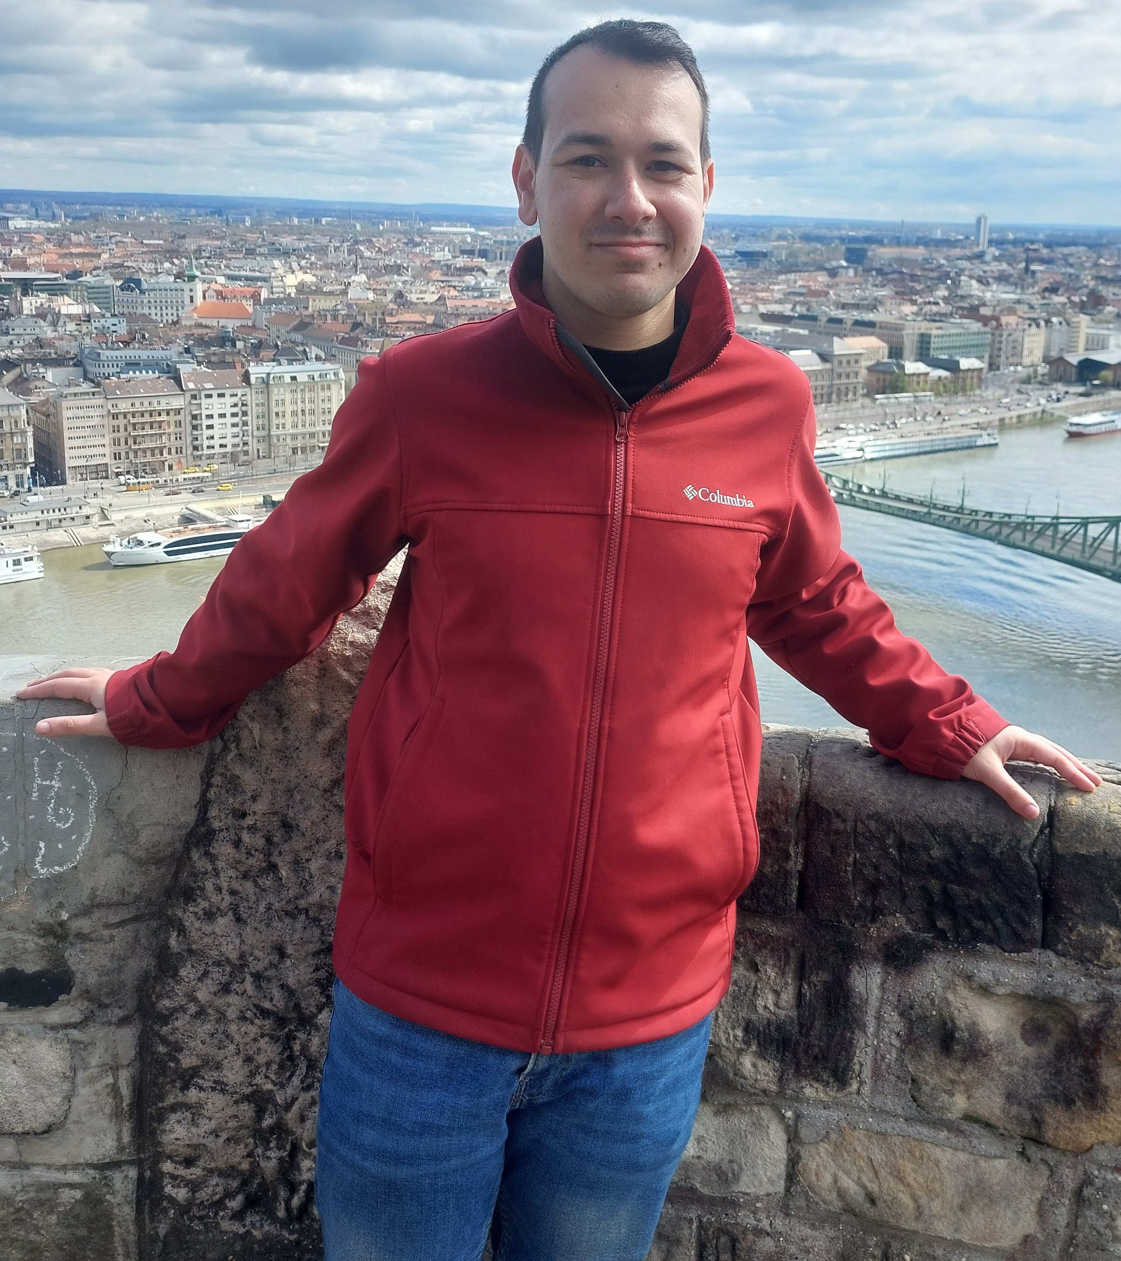

Course: Image Processing 31651
Assignment #14
Synthetic Image Creation (Part 4)
Photo of the student | Shorten Name | ID (4 last digits)
 | shienfeld | 1950 | Student #1
 | pony | 2210 | Student #2
 | akimov | 7939 | Student #3
Photo of the student | Shorten Name | ID (4 last digits)
 | shienfeld | 1950 | Student #1
 | pony | 2210 | Student #2
 | akimov | 7939 | Student #3

Slide 2
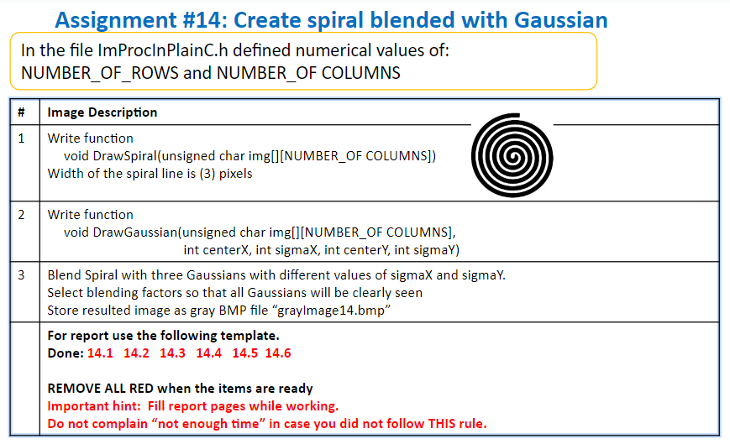

Slide 3
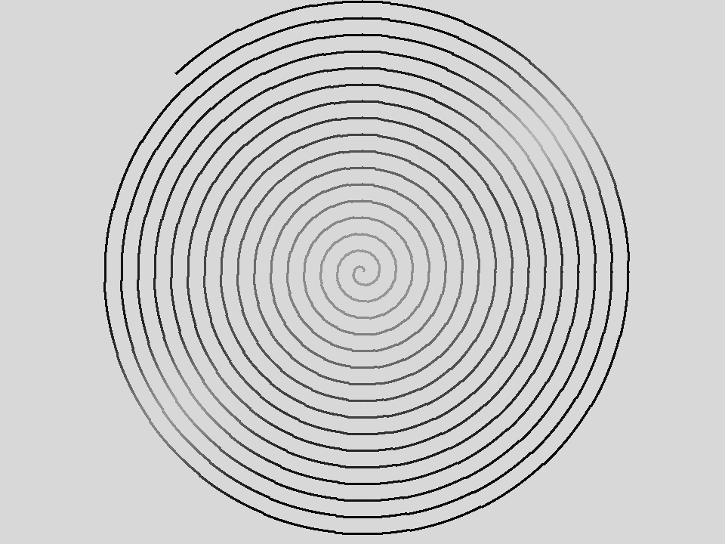
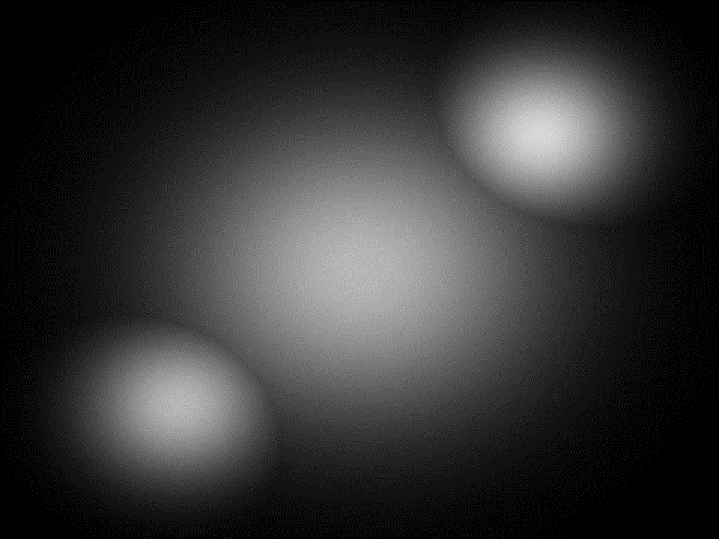
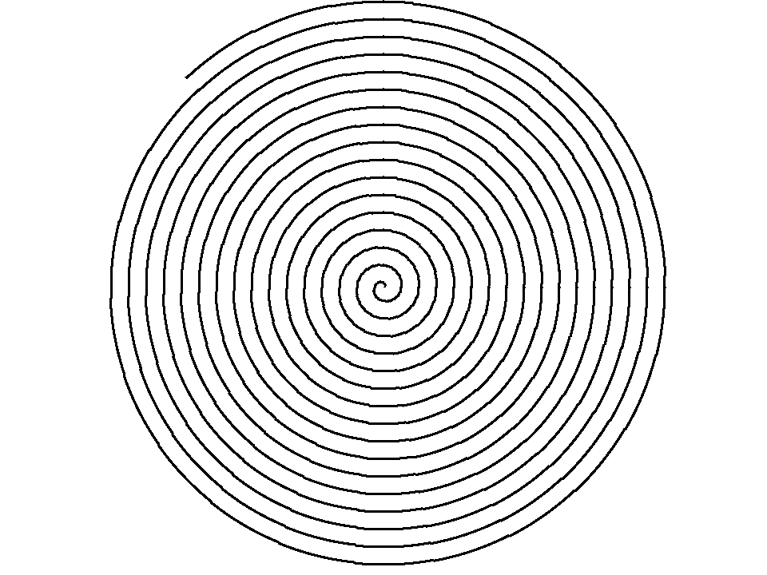
14.1 - our “image of spiral”, “images of Gaussian”
and resulted blended image “grayImage14.bmp”
This image contains a spiral pattern. The background is uniformly white, making the black spiral lines more distinct and clearer.
This image features a spiral pattern with gradually increasing radius, starting from the center and moving outward. The background contains the 3 gaussians patterns. The combined background is gray as a combination of the blended images. Pay attention (shown and approved by the lecturer) that the gaussians are not so easy to be seen but will be proved using profiles
This image depicts 3 Gaussian patterns. In each gaussian pattern-the intensity of the pixels decreases smoothly from the center towards the edges, forming a bright spot in the middle that gradually fades to black.

Slide 4
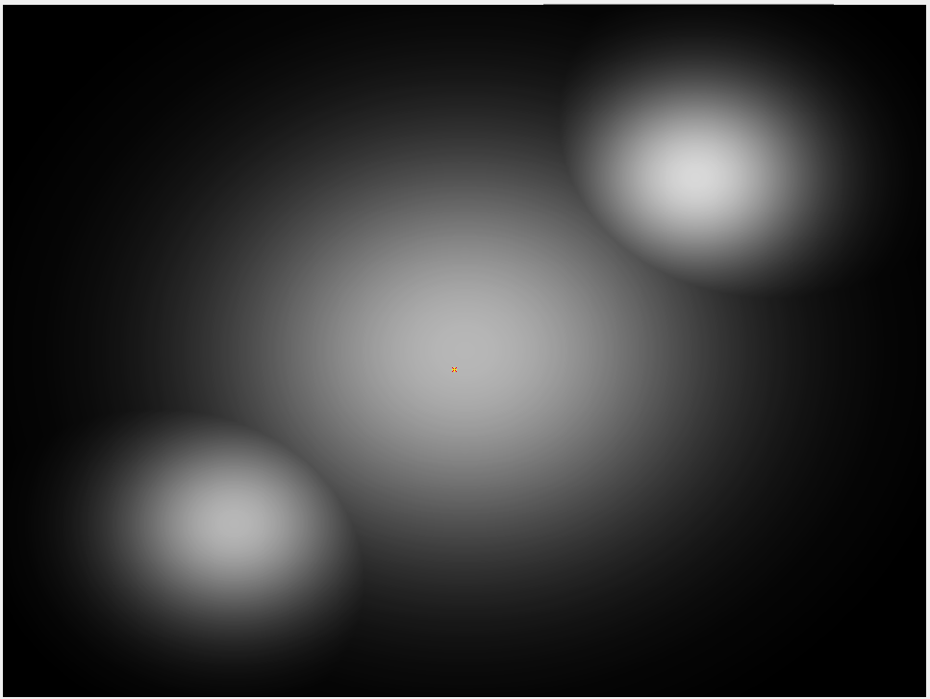
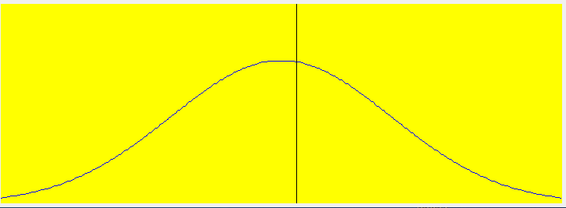
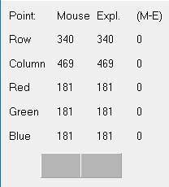
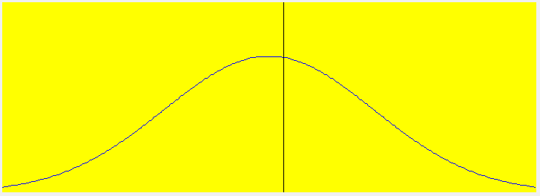
14.2 - The Relevant Profiles (of all relevant images)
(to prove that image “grayImage14.bmp” was created as required) - part 1/7
Row view
The point that we selected first to present is the “central point” of the central gaussian. The row and column views show the same profile which is a clear and perfect gaussian. The presented profiles approve the creation of the 1/3 gaussian as required.
Column view
location
RGB values

Slide 5
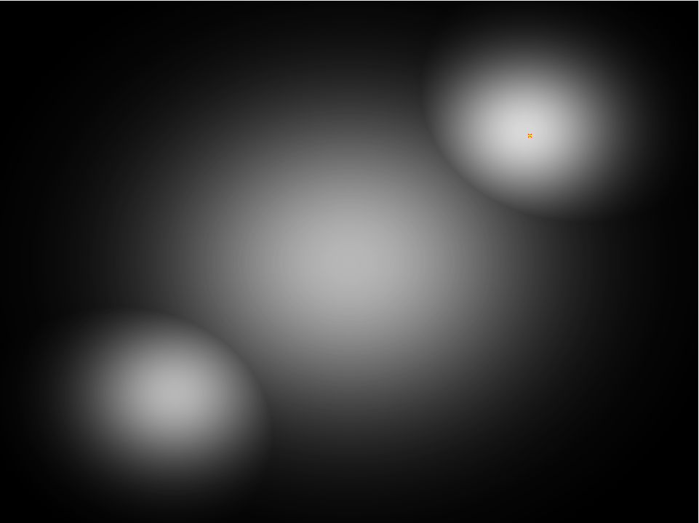
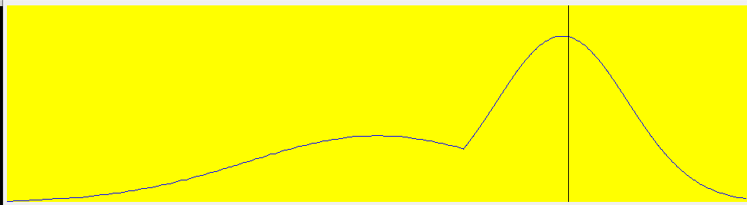
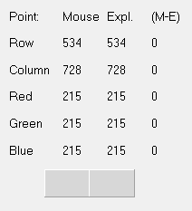
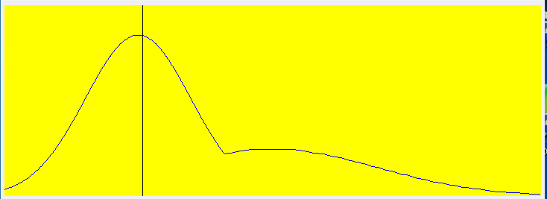
14.2 - The Relevant Profiles (of all relevant images)
(to prove that image “grayImage14.bmp” was created as required) - part 2/7
Row view
The point that we selected second to present is the “central point” of the upper right gaussian. The row and column views show a disrupted gaussian (pay attention to the reflected structure). The distruption in the gaussian pattern is due to the congruence with the central gaussian.
Column view
location
RGB values

Slide 6
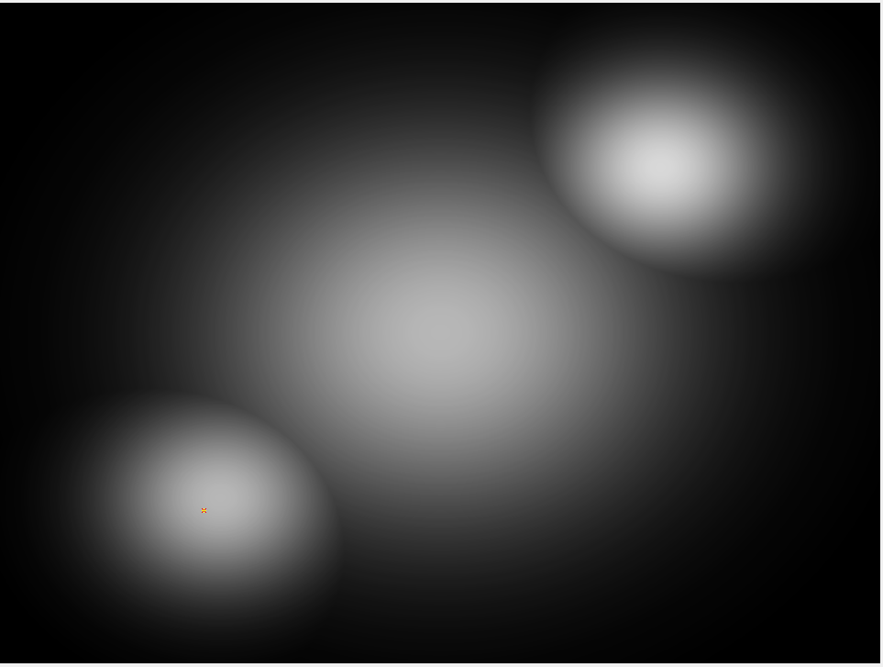
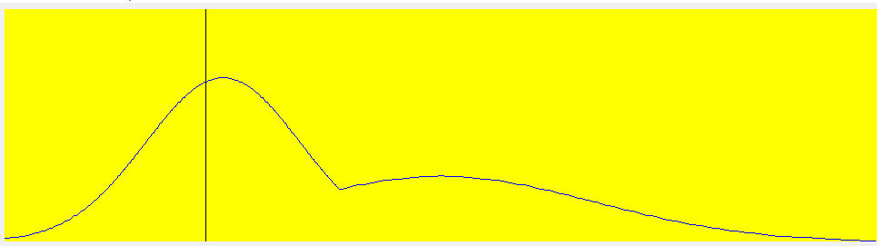
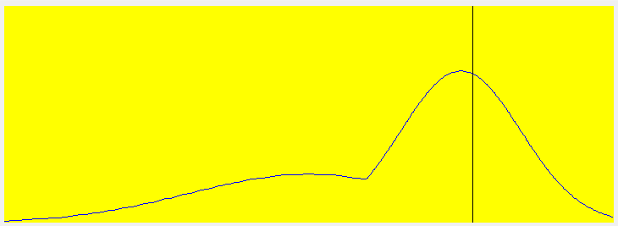
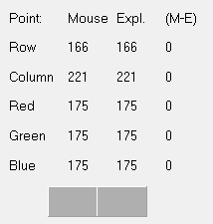
14.2 - The Relevant Profiles (of all relevant images)
(to prove that image “grayImage14.bmp” was created as required) - part 3/7
Row view
The point that we selected third to present is the “central point” of the lower left gaussian. The row and column views show a disrupted gaussian (pay attention to the reflected structure). The distruption in the gaussian pattern is due to the congruence with the central gaussian.
Column view
location
RGB values

Slide 7
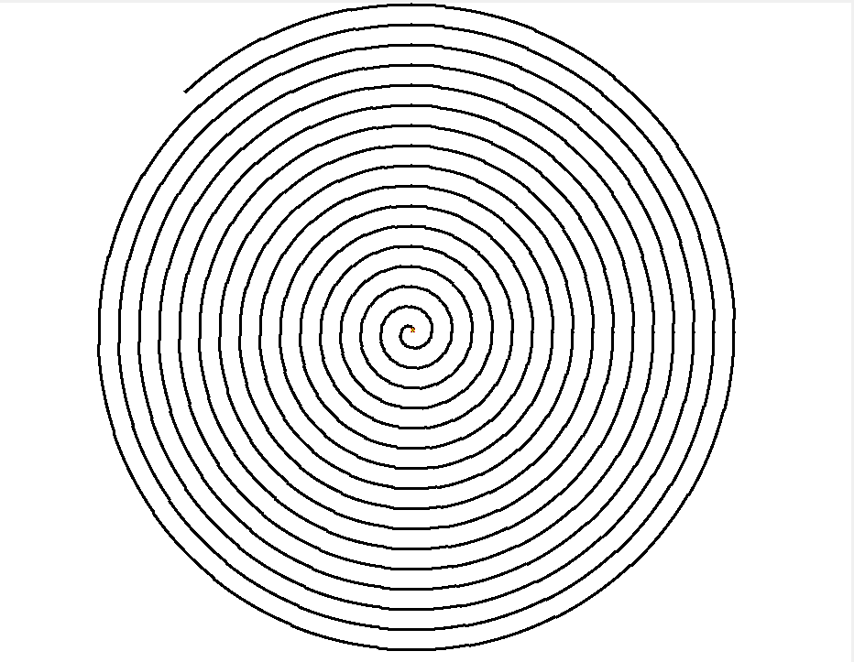
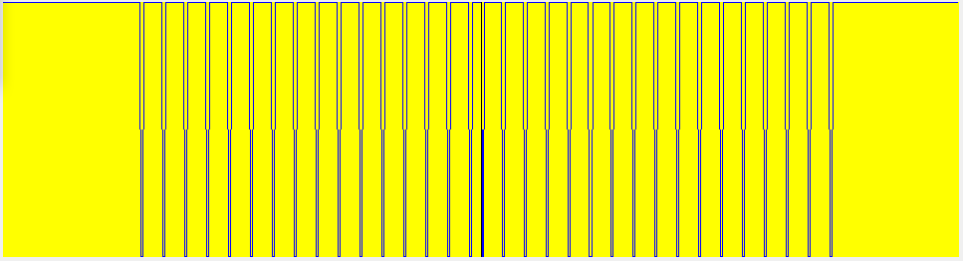
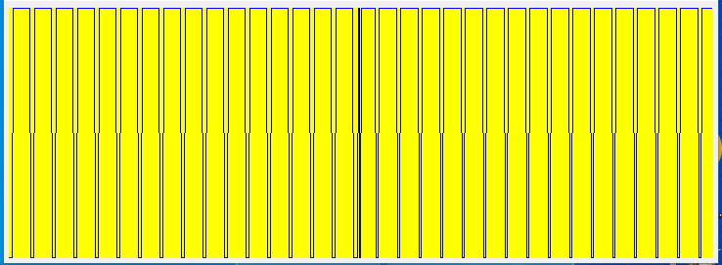
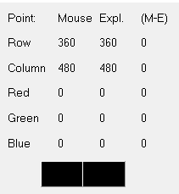
14.2 - The Relevant Profiles (of all relevant images)
(to prove that image “grayImage14.bmp” was created as required) - part 4/7
Row view
Again – the point we selected is the central point of the object – in this case it is the spiral. The profiles show a rectangular periodic function. Pay attention to the white space in the row view (level of 255) as the main difference between the row and the column profilers.
Column view
location
RGB
values

Slide 8
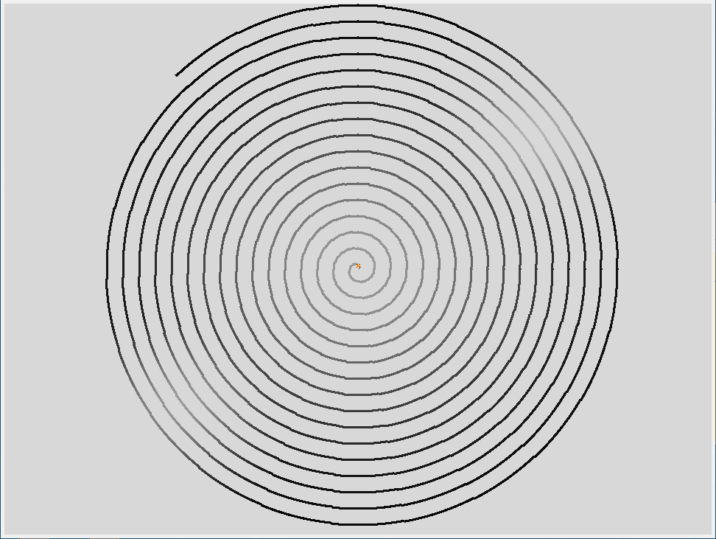
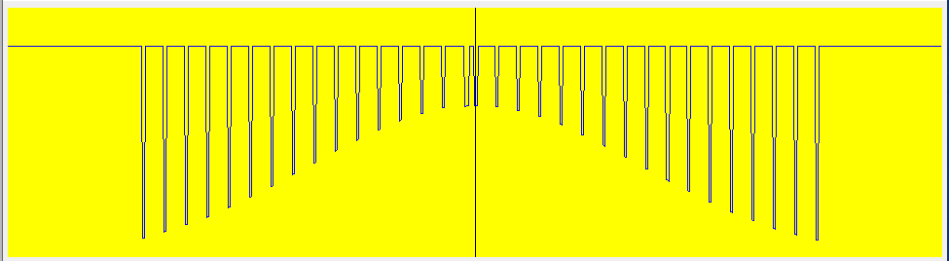
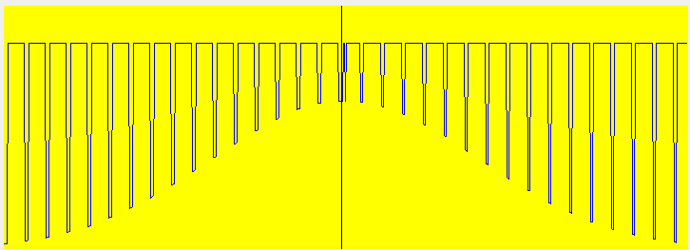
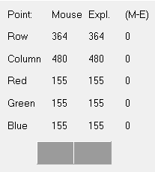
14.2 - The Relevant Profiles (of all relevant images)
(to prove that image “grayImage14.bmp” was created as required) - part 5/7
row
To consistent with part 1/7 of this section – we can see the same point but now the rectengualar pattern that “rides” on the gaussian pattern (like a signal and an envelop). The row and the column views present almost the same pattern.
Column view
location
RGB values

Slide 9

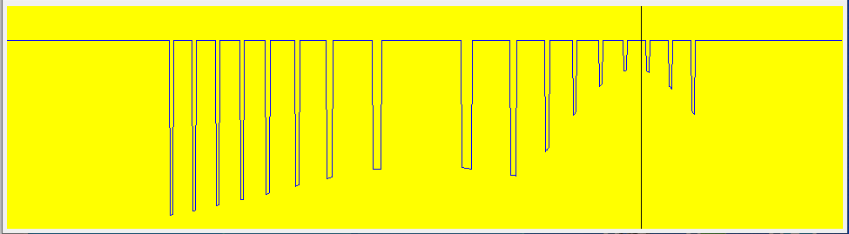
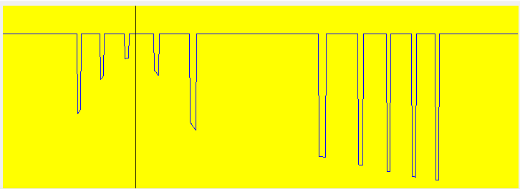
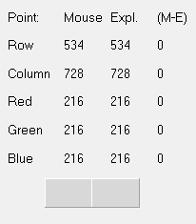
14.2 - The Relevant Profiles (of all relevant images)
(to prove that image “grayImage14.bmp” was created as required) - part 6/7
row
To consistent with part 2/7 of this section – we can see the same point but now the rectangular pattern is disrupted due to the gaussian and the congruence with the central gaussian.
If the gaussians were not congruence than we would have get the same perfect result as in part 5/7.
column
location
RGB values

Slide 10
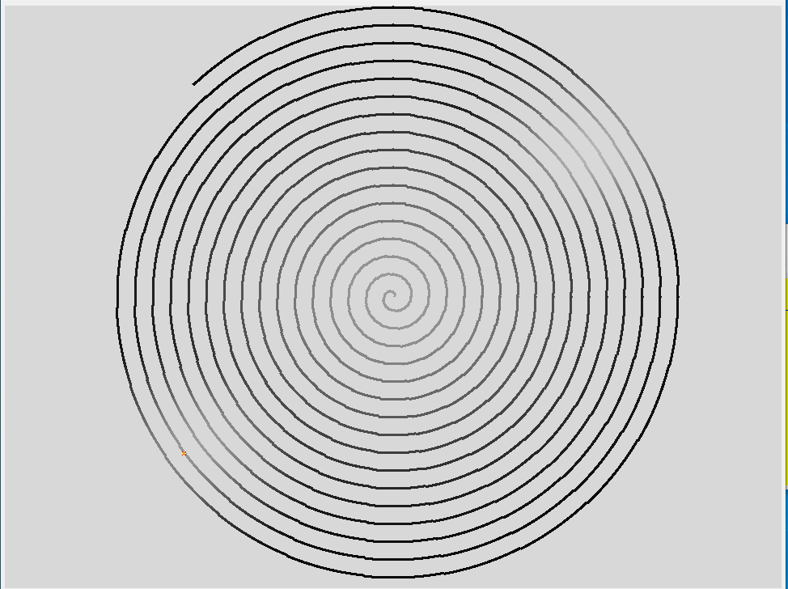
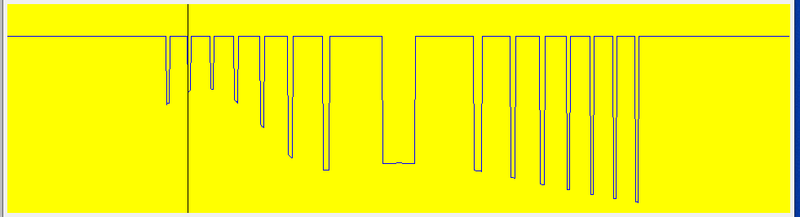
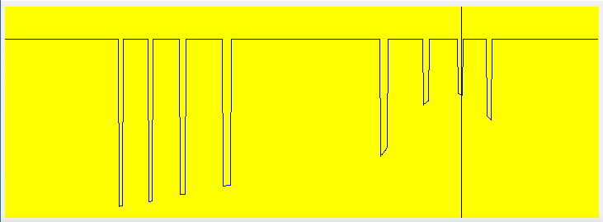
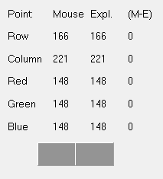
14.2 - The Relevant Profiles (of all relevant images)
(to prove that image “grayImage14.bmp” was created as required) - part 7/7
row
To consistent with part 3/7 of this section – we can see the same point but now the rectangular pattern is disrupted due to the gaussian and the congruence with the central gaussian.
If the gaussians were not congruence than we would have get the same perfect result as in part 5/7. the result is a mirror of the result in part 6/7.
column
location
RGB values

Slide 11
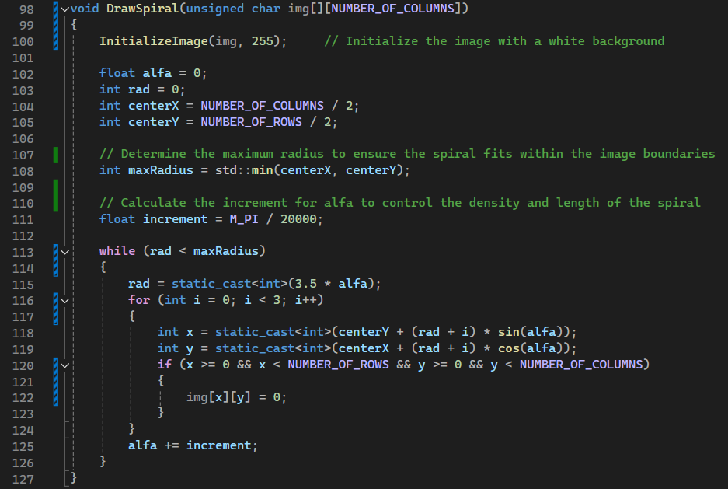

14.3 - Code of the function “DrawSpiral”
alfa is the angle used in the spiral equation.
rad is the radius of the spiral.
centerX and centerY represent the center of the image.
The while loop continues until the radius rad exceeds the maximum radius. The radius rad is calculated as 3.5 * alfa. This equation defines how the spiral expands as alfa increases. For each step, a small segment of the spiral is drawn by incrementing the radius slightly (from rad to rad + 2).
The pixel coordinates x and y are calculated using polar-to-Cartesian conversion:
$$x=centerY+rad×sin⁡(alfa)$$
$$y=centerX+rad×cos⁡(alfa)$$

Slide 12
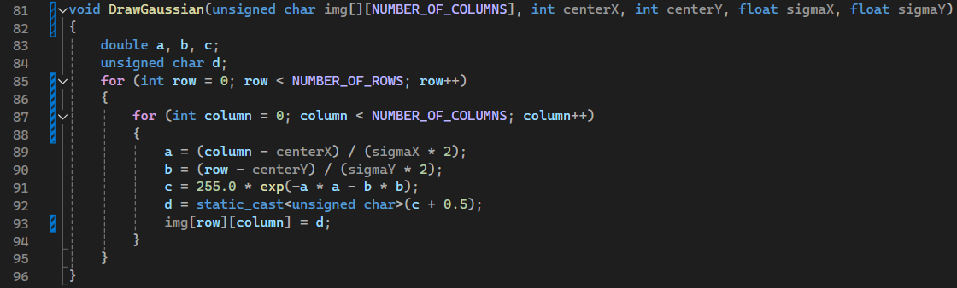
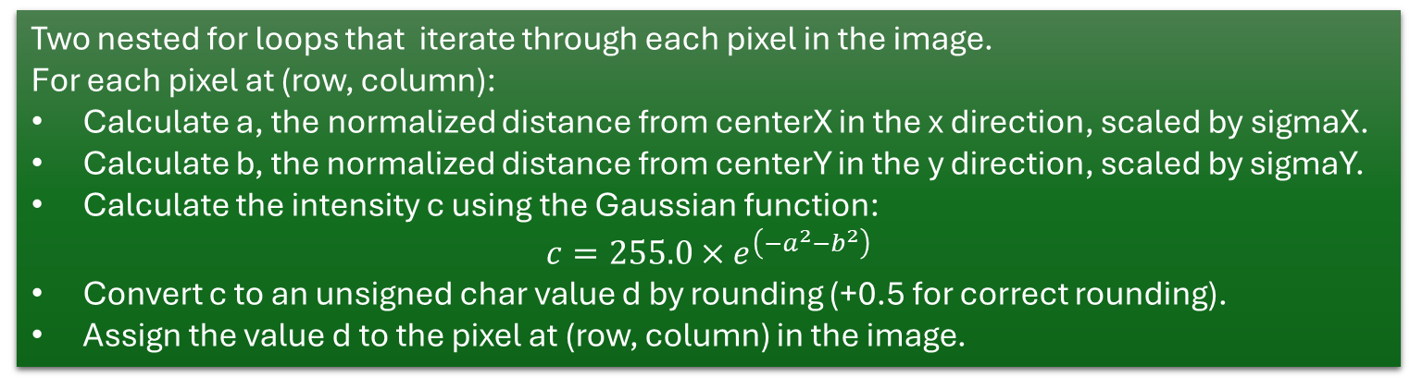
14.4 - Code of the function “DrawGaussian”
a and b are variables for the normalized distances from the center in the x and y directions, respectively.
c holds the calculated intensity value.
d is the final pixel value after rounding.
Two nested for loops that iterate through each pixel in the image.
For each pixel at (row, column):
Calculate a, the normalized distance from centerX in the x direction, scaled by sigmaX.
Calculate b, the normalized distance from centerY in the y direction, scaled by sigmaY.
Calculate the intensity c using the Gaussian function:
$$c=255.0×e^{\left(−a^{2}−b^{2}\right)}$$
Convert c to an unsigned char value d by rounding (+0.5 for correct rounding).
Assign the value d to the pixel at (row, column) in the image.

Slide 13
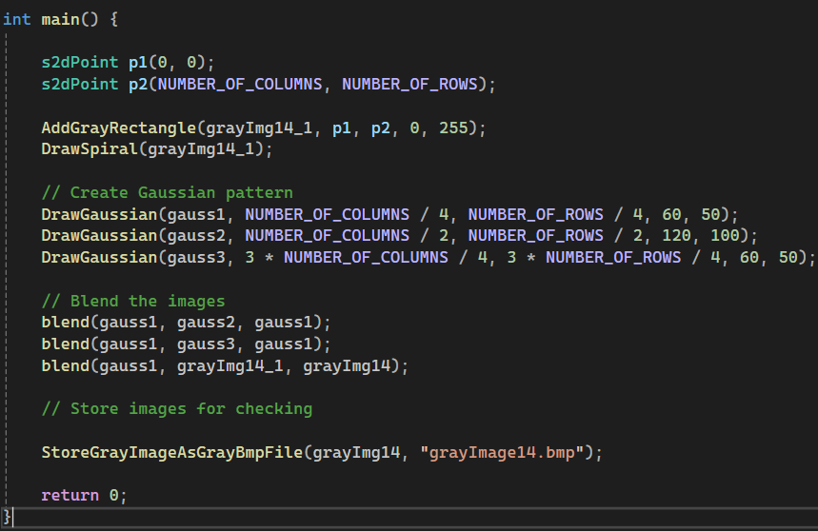
14.5 - Code of the “main” function
p1 and p2 are instances of s2dPoint representing two corners of the rectangle. The struct is located in the header file and makes sure to automatically validate the validity of the points.
Adds a gray rectangle to grayImg14_1 covering the entire image with a gradient from transparency 0 to gray level of 255 (white). grayImg14_1 is the name of the stand alone spiral pattern.
Draws the 3 gaussians in different locations on the image – each with different standard deviations (x &y)
Blends gauss1 and gauss2, storing the result back in gauss1.
Then , Blends the result in gauss1 with gauss3, again storing the result back in gauss1.
Finally, blends the result in gauss1 , storing the final blended image in grayImg14.

Slide 14
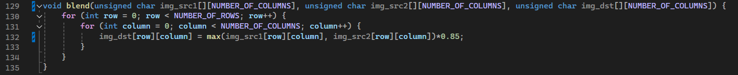
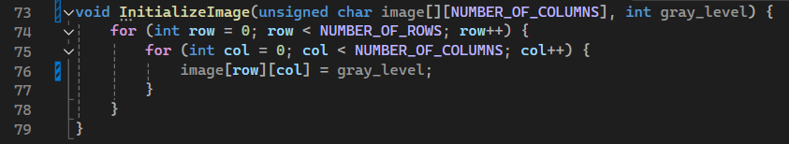
(+) – some additional functions we had to use – part 1
Two nested for loops iterate through each pixel in the images.
For each pixel at (row, column): computes the maximum value between the corresponding pixels from the two source images.
The result is then multiplied by 0.85 to apply a blending factor.
Initialize image is a simple function for creating the basis for the task.

Slide 15
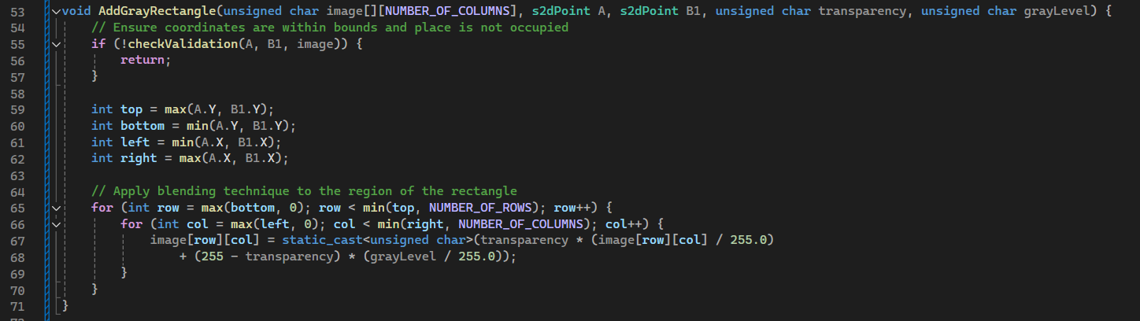
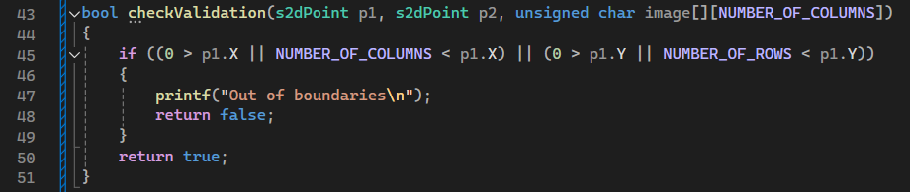
(+) – some additional functions we had to use – part 2
We already used these functions in Assignment 11 & 12 so they will just be presented for the protocol without further explanation

Slide 16
14.6 - What did we learned
How to Apply mathematical formulas in a programming context (e.g., Gaussian distribution, trigonometric functions for drawing spirals).
Drawing shapes (e.g., rectangles and spirals) by converting geometric formulas into pixel operations.
Implementing and understanding coordinate transformations (e.g., polar to Cartesian for the spiral).
Learning about the effects of different parameters (e.g., sigma values) on Gaussian distributions.
Designing and implementing blending algorithms to combine multiple images.

